Slide 1


Summer Olympics Analysis Project

Slide 2




DATASET
THE DATASET OF SUMMER OLYMPICS IS TAKEN FROM KAGGLE.
.

Slide 3
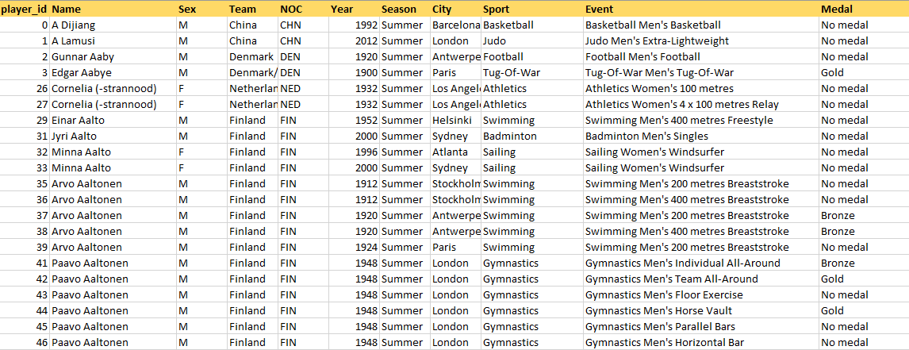
ABOUT DATASET
Teddy Yu
AVERY DAVIS

Slide 4



Steps Involves
PLAYER
1.DATA LOADING,CLEANING AND PREPROCESSING
2.PIVOT TABLES FOR ANALYSIS
3.OLYMPICS DASHBOARD

Slide 5
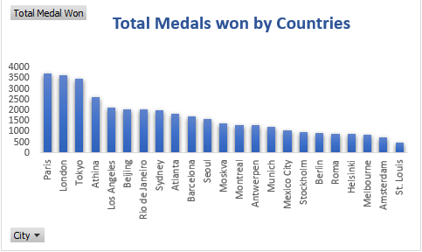
INSIGHTS
It shows the total number of Olympic medals won by various countries across different host cities. Paris, London, and Tokyo lead in total medal counts, each with over 3,500 medals.

Slide 6
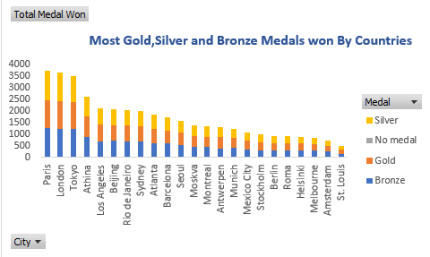
INSIGHTS
The chart shows that Paris, London, and Tokyo have won the most total medals,.
Gold medals are the most frequently won across many countries, followed by silver and bronze.
There is a noticeable decline in the number of medals won by countries in later hosting cities, such as Helsinki, Melbourne, and St. Louis, compared to earlier ones like Paris and London.

Slide 7
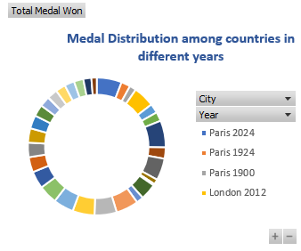
INSIGHTS
It can be analysed that Paris has won the most medals ,2281 in year 2024.
Then London has won most
medals ,1941 in year 2012.
After that , Tokyo won 2449 medals in year 2020.

Slide 8
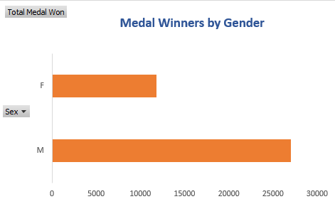
INSIGHTS
The chart reveals that most of medals (Gold,Silver and Bronze ) are won by Male than Females.

Slide 9
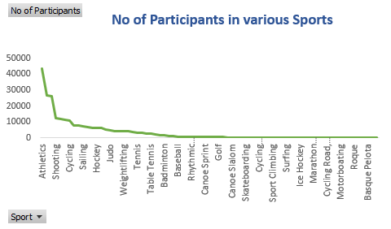
INSIGHTS
Sports like Atheletics,Gymnastics and Swimming have the highest number of participants in summer olympics.

Slide 10
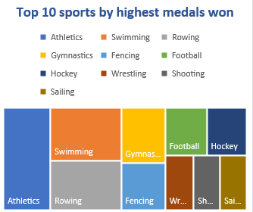
INSIGHTS
Sports like Atheletics, Swimming,Rolling ,Wrestling and Shooting etc are the top Sports in which maximum medals are won by participants in summer olympics.

Slide 11
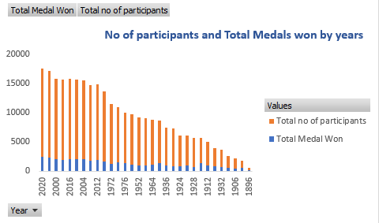
INSIGHTS
Years like 2020,2024 ,2000,2016 and 2008 etc have the highest total of number of participants and medals won in these years.

Slide 12


Thank
YOU

